Slide 1
CSC111
Introduction to Computer Science
Course Instructors:
Prof. B. S. Aribisala
Dr. U. C. Ogude
Department of Computer Science
Lagos State of University

Slide 2
Computer Processing Models and Networking
Processing Models
Batch Processing
Real-Time Processing
On-Line Processing
Time-Sharing Processing
Distributed Data Processing
Networks
Hierarchical Networks
Peer to Pear Networks
Local Area Networks (LAN)
Wide Area Networks (WAN)
Internet
Security on Networks

Slide 3
BATCH PROCESSING
Batch processing is the processing of transactions in a group or batch.
No user interaction is required once batch processing is underway.
This differentiates batch processing from transaction processing, which involves processing transactions one at a time and requires user interaction.
Batch processing can be carried out at any time, it is particularly suitable to end-of-cycle processing, such as for processing a bank's reports at the end of a day or generating monthly or biweekly payrolls.

Slide 4
NOTE:
Batch processing is a technique for automating and processing multiple transactions as a single group.
Batch processing helps in handling tasks like payroll, end-of-month reconciliation, or settling trades overnight.
Batch processing systems can save money and labor over time, but they may be costly to design and implement up-front.

Slide 5
Understanding Batch Processing
Batch processing jobs are run on regularly scheduled times (e.g., overnight) or on an as-needed basis. Example, bills for utilities and other services received by consumers are typically generated by batch processing each month.
Batch processing is beneficial because it is a cost-effective means of handling large amounts of data at once.
One requirement is that the inputs for the processing must be correct or else the results of the whole batch will be faulty, which would cost time and money.

Slide 6
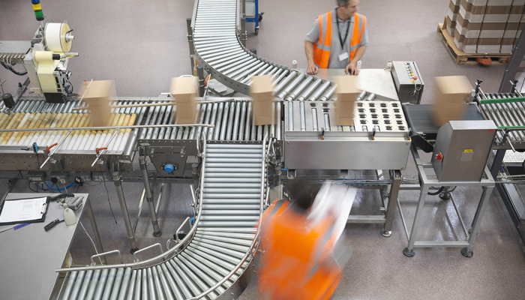
Batch Processing

Slide 7
Real-Time Processing
Real Time = immediately, now
Real-time data processing is the execution of data in a short time period, providing near speedy output.
The processing is done as the data is inputted, so it needs a continuous stream of input data in order to provide a continuous output.
In contrast, a batch data processing system collects data and then processes all the data in bulk in a later time, which also means output is received at a later time.
Real-time data processing is also known as stream processing.

Slide 8
Examples of real-time data processing systems are:
Bank ATMs,
traffic control systems
modern computer systems such as the PC
mobile devices.
Requirements
Real-Time Processing requires dual-purpose input and output devices, such as terminal and VDUs.
Uses
It is useful in specialized or transaction applications, and in situations where time is a critical factor, e.g. in airline reservations, banks, e.t.c

Slide 9
  On-line Processing
  It concern the equipment which is connected or re-engaged and functioning with the CPU and main Programs, e.g. teletype units, consoles card-readers, OCR, VDU etc.
  It is at least a one-way communication between operators at terminals and the CPU.
  Note:
  An On-line system is not always a real time (Immediately inquiry response) System, but real-time systems must have an On-line Capability and equipment.

Slide 10
Time-sharing Processing
Time-sharing, in data processing, method of operation in which multiple users with different programs interact nearly concurrently with the central processing unit of a large-scale digital computer.
the central processor operates significantly faster
it has sufficient time to solve several discrete problems during the input/output process.

Slide 11
Time-sharing Processing
Time-sharing was developed during the late 1950s and early ’60s to make more efficient use of expensive processor time.
Commonly used time-sharing techniques include multiprocessing, parallel operation, and multiprogramming.
Computer networks organized for the purpose of exchanging data and resources are centred on time-sharing systems.

Slide 12
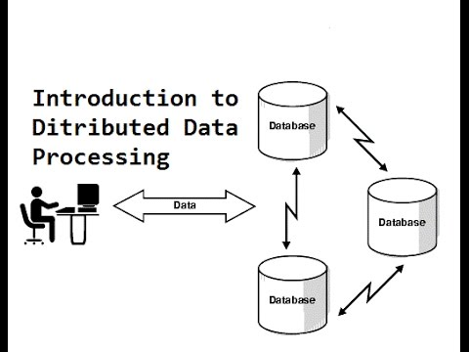
Distributed Data Processing
Distributed data processing is a computer-networking method in which multiple computers across different locations share computer-processing capability.
This is in contrast to a single, centralized server managing and providing processing capability to all connected systems.
Computers that comprise the distributed data-processing network are located at different locations but interconnected by means of wireless or satellite links.

Slide 13
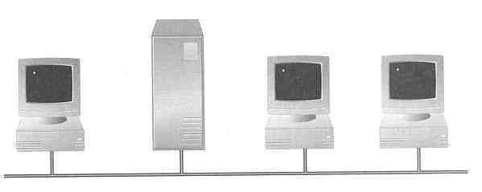

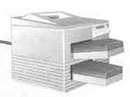
Networking
  A network consists of 2 or more computers connected together, and they can communicate and share resources (e.g. information)
A network connects one computer to other computers and peripheral devices, enabling you to share data and resources with others
A network consists of two or more computers that are linked in order to share resources (such as printers and CDs), exchange files, or allow electronic communications.

Slide 14
Networking
Network: A collection of computing devices that are connected in various ways in order to communicate and share resources
Usually, the connections between computers in a network are made using physical wires or cables
  The computers on a network may be linked through cables, telephone lines, radio waves, satellites, or infrared light beams.
  However, some connections are wireless, using radio waves or infrared signals

Slide 15
Networking
The generic (basic) term node or host refers to any device on a network
Data transfer rate The speed with which data is moved from one place on a network to another
Data transfer rate is a key issue in computer networks
Server:
Any device on a network providing a special engine service.
File server A computer that stores and manages files for multiple users on a network
Web server A computer dedicated to responding to requests (from the browser client) for web pages

Slide 16
File Transfer:
This is core of LAN. It is a microcomputer that runs the network operating system and controls the activities of the network.
Host:
A computer within a network designed for running application, time-sharing operations, services like database access, and special programs or languages a workstation.
Node: Any device PC or terminal on a LAN
Protocol:
A set of rules governing data transmission. All devices involved with sending or Receiving of data on the network must accept the procedure in order to communicate.

Slide 17
Bridge:
Any device (i.e combination of hardware and software) that can form an interface between two similar LANs.
Routers:
While bridges can link similar LANs that do not necessarily have the same protocols, a router can only send data through compatible protocols path.
Repeater:
A device set of interval along a circuit to regenerate or boost the signal preventing its decay over distance. Repeaters regenerate digital signals without change; they simply boost analog signals.
Topology:
This refers to the configuration among nodes, including the wiring scheme (ring, bus or star)

Slide 18
Hierarchical Networks
A hierarchical network is the type of network topology in which a central "root" node (the top level of the hierarchy) is connected to one or more other nodes that are one level lower in the hierarchy (i.e., the second level) with a point-to-point link between each of the second level nodes and the top level central "root" node,
while each of the second level nodes that are connected to the top level central "root" node will also have one or more other nodes that are one level lower in the hierarchy (i.e., the third level) connected to it, also with a point-to-point link, the top level central "root" node being the only node that has no other node above it in the hierarchy.

Slide 19
Peer-to-Peer Networks (P2P)
In a P2P network, the "peers" are computer systems which are connected to each other via the Internet.
Files can be shared directly between systems on the network without the need of a central server, that is, each computer on a P2P network becomes a file server as well as a client.
The only requirements for a computer to join a peer-to-peer network are Internet connection and P2P software.

Slide 20
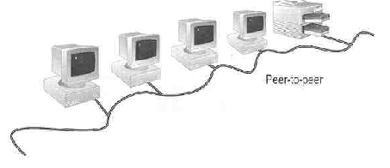
Peer-to-Peer Networks
Peer-to-peer network is also called workgroup
No hierarchy among computers ⇒ all are equal
No administrator responsible for the network
Peer-to-peer

Slide 21
Advantages of peer-to-peer networks:
  Low cost
  Simple to configure
  User has full accessibility of the computer
Disadvantages of peer-to-peer networks:
  May have duplication in resources
  Difficult to uphold security policy
  Difficult to handle uneven loading
Where peer-to-peer network is appropriate:
  10 or less users
  No specialized services required
  Security is not an issue
  Only limited growth in the foreseeable future

Slide 22
  Clients and Servers
  Network Clients (Workstation)
    Computers that request network resources or services
  Network Servers
    Computers that manage and provide network resources and services to clients
      Usually have more processing power, memory and hard disk space than clients
      Run Network Operating System that can manage not only data, but also users, groups, security, and applications on the network
      Servers often have a more stringent requirement on its performance and reliability

Slide 23
Advantages of client/server networks
  Facilitate resource sharing – centrally administrate and control
  Facilitate system backup and improve fault tolerance
  Enhance security – only administrator can have access to Server
  Support more users – difficult to achieve with peer-to-peer networks
Disadvantages of client/server networks
  High cost for Servers
  Need expert to configure the network
  Introduce a single point of failure to the system

Slide 24
Types of Networks
Local Area Networks (LAN)
Wire Area Networks (WAN)

Slide 25
Local Area Networks (LAN)
Local Area Network (LAN) A network that connects a relatively small number of machines in a relatively close geographical area
  Small network, short distance
    A room, a floor, a building
    Limited by no. of computers and distance covered
    Usually one kind of technology throughout the LAN
    Serve a department within an organization
  Examples:
    Network inside the Student Computer Room
    Network inside CF502
    Network inside your home

Slide 26
Various configurations, called topologies, have been used to administer LANs
  Ring topology A configuration that connects all nodes in a closed loop on which messages travel in one direction
  Star topology A configuration that centers around one node to which all others are connected and through which all messages are sent
  Bus topology All nodes are connected to a single communication line that carries messages in both directions

Slide 27
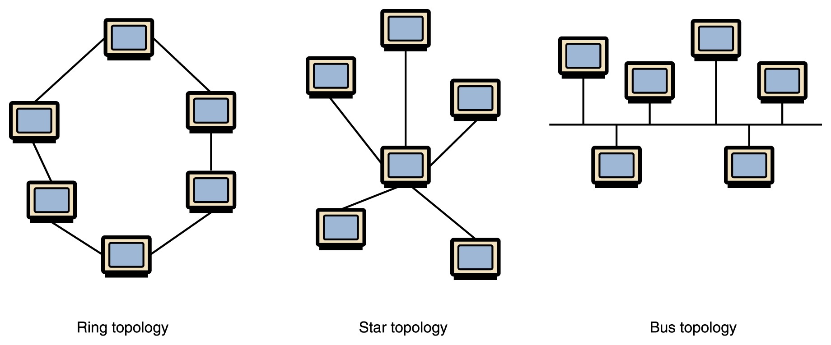
Various Network Topologies
A bus technology called Ethernet has become the industry standard for local-area networks

Slide 28
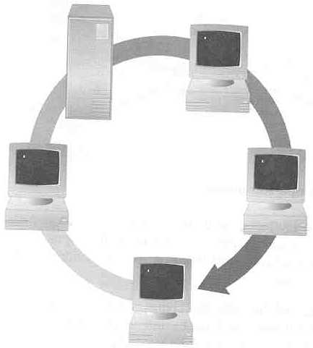
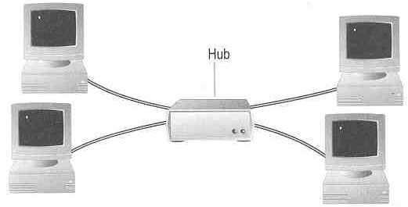
Topology ― 3 basic types
How so many computers are connected together?
  Bus Topology Ring Topology
  Star Topology
Hub

Slide 29
  Bus Topology
    Simple and low-cost
    A single cable called a trunk (backbone, segment)
    Only one computer can send messages at a time
    Passive topology - computer only listen for, not regenerate data
  Star Topology
    Each computer has a cable connected to a single point
    More cabling, hence higher cost
    All signals transmission through the hub; if down, entire network down
    Depending on the intelligence of hub, two or more computers may send message at the same time

Slide 30
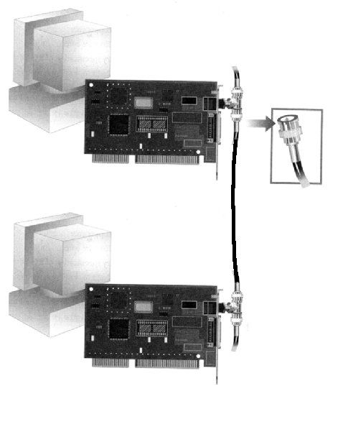
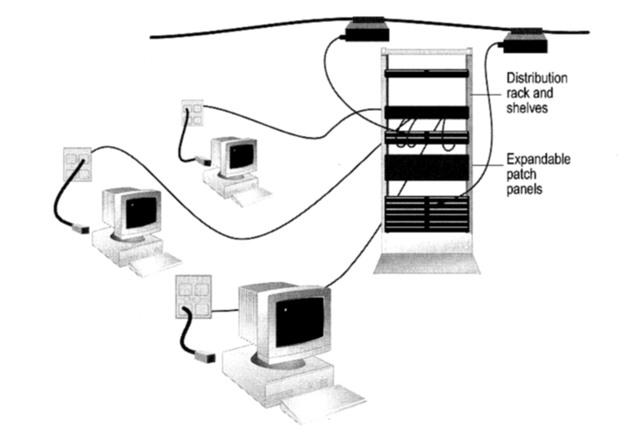
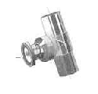
How to construct a network with Bus / Star Topology?
  Bus Topology
  Star Topology
Coaxial cable
BNC T-Connector
Network Card

Slide 31
Ring Topology
  Every computer serves as a repeater to boost signals
  Typical way to send data:
    Token passing
      only the computer who gets the token can send data
  Disadvantages
    Difficult to add computers
    More expensive
    If one computer fails, whole network fails
Ack
T
T
T
T
T
data
data
T
data
data
data
T
T
T
Ack
T
T
Ack
data
T
T
Ack

Slide 32
Wide Area Networks (LAN)
Wide Area Network (WAN): A network that connects two or more local area networks over a large geographic distance or area
One particular node on a LAN is set up to serve as a gateway to handle all communication going between that LAN and other networks Communication between networks is called internetworking
  The Internet, as we know it today, is essentially the ultimate wide area network, spanning the entire globe

Slide 33
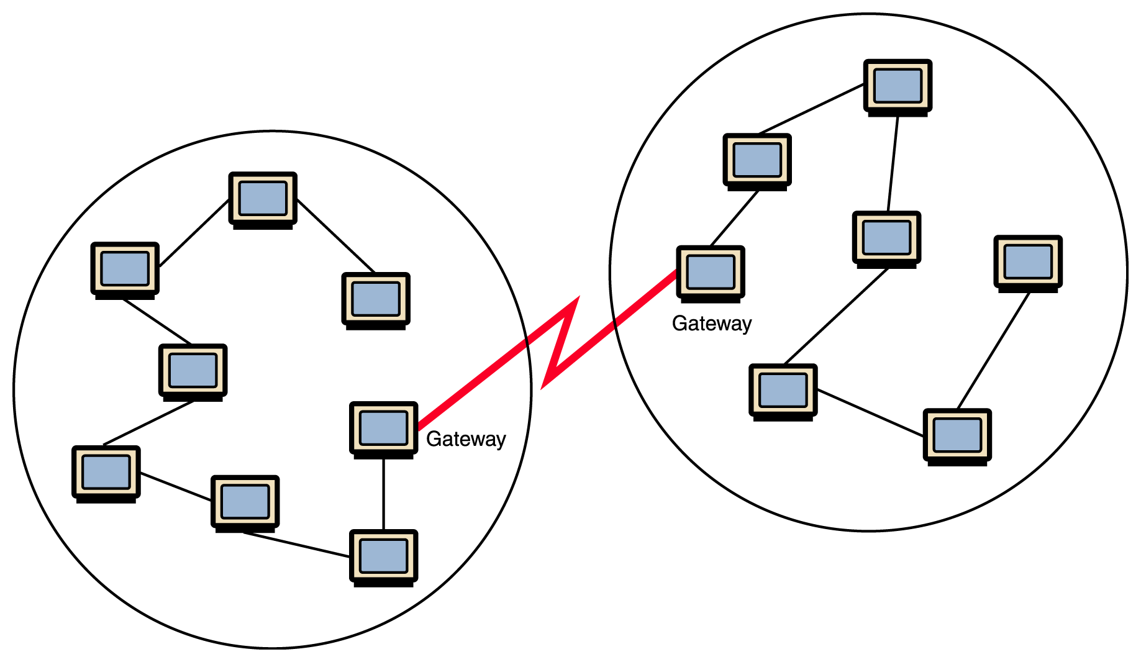
Local Area Networks connected across a distance to create a Wide Area Network
Gateways: Gateways are used to connect dissimilar networks.
Gateways handle messages, addresses, and protocol conversions necessary to deliver a message from one network or another.

Slide 34
Wide Area Network (WAN)
  A network that uses long-range telecommunication links to connect 2 or more LANs/computers housed in different places far apart. Towns, states, countries
  Examples:
    Network of our Campus
    Internet
    Banks and Oil companies with different offices
    all over the country
Your home
WAN
USA
Student Computer Centre

Slide 35
Metropolitan Area Network (MAN)
Metropolitan Area Network (MAN): The communication infrastructures that have been developed in and around large cities.
Metropolitan Area Network (MAN) : LAN limited to one city or metropolis

Slide 36
Internet
The internet is a globally connected network system that uses TCP/IP to transmit data via various types of media.
The internet is a network of global exchanges – including private, public, business, academic and government networks – connected by guided, wireless and fiber-optic technologies.
The Internet is the largest network in the world, connecting millions of people
  Electronic mail
  World Wide Web
    Web page
    Web site

Slide 37
The terms internet and World Wide Web are often used interchangeably, but they are not exactly the same thing
The internet refers to the global communication system, including hardware and infrastructure, while the web is one of the services communicated over the internet.

Slide 38
So, who owns the Internet?
Well, nobody does. No single person or company owns the Internet or even controls it entirely.
As a wide-area network, it is made up of many smaller networks. These smaller networks are often owned and managed by a person or organization.
The Internet, then, is really defined by how connections can be made between these networks.

Slide 39
Internet Connections
Internet backbone A set of high-speed networks that carry Internet traffic
These networks are provided by companies such as AT&T, GTE, and IBM
Internet service provider (ISP) A company that provides other companies or individuals with access to the Internet

Slide 40
Internet Connections
There are various technologies available that you can use to connect a home computer to the Internet
  A phone modem converts computer data into an analog audio signal for transfer over a telephone line, and then a modem at the destination converts it back again into data
  A digital subscriber line (DSL) uses regular copper phone lines to transfer digital data to and from the phone company’s central office
  A cable modem uses the same line that your cable TV signals come in on to transfer the data back and forth

Slide 41
Internet Connections
Broadband A connection in which transfer speeds are faster than 128 bits per second
  DSL connections and cable modems are broadband connections
  The speed for downloads (getting data from the Internet to your home computer) may not be the same as uploads (sending data from your home computer to the Internet)

Slide 42
Security on Networks
Security refers to the steps a computer owner takes to prevent unauthorized use of or damage to the computer
  Malware
    Viruses
      Antivirus software
    Spyware
    Adware
Firewall
Phishing
Pharming

Slide 43
Security on Networks
Password protection can prevent people accessing computer systems, accounts, files or parts of files by requiring a user to enter a password.
This prevents people damaging files or getting into e-mail accounts or network accounts and disrupting them.
It is a standard security precaution on many computer systems.
Password security is at no cost to the network and is potential a useful security measures. Password that are chosen should be those that could be easily remembered.

